Slide 1

Department of Avionics,
Indian Institute of Space Science and Technology
AV224 - Computer Organization & Operating Systems
Instructor: Vineeth B. S. (vineethbs@iist.ac.in)
Lecture 12
07/02/2017

Slide 2
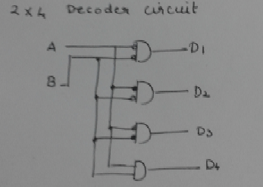
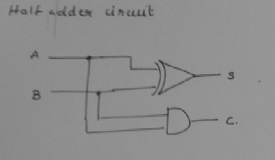
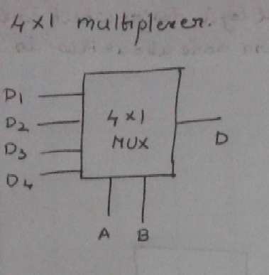
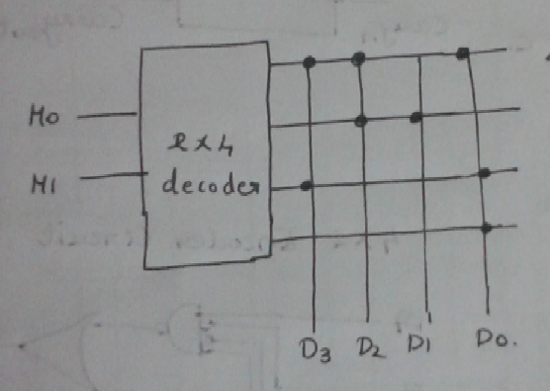
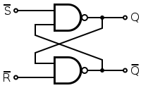
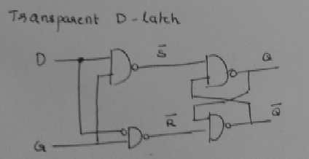
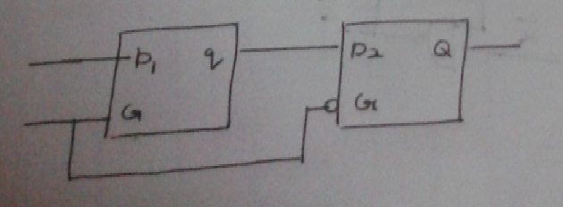
Review ...
Design of a simple processor (which executes a single instruction)
To add together four two bit numbers sequentially
Review of digital circuits
Half and full adders
Decoders and Encoders
Muxes and Demuxes
Read only memory (ROM)
SR latch
Transparent D latch
Edge triggered D flip flop
Tristate buffer
A memory cell
Memory device for storing four 2 bit numbers

Slide 3
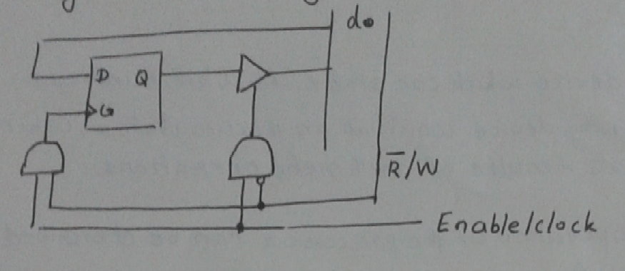
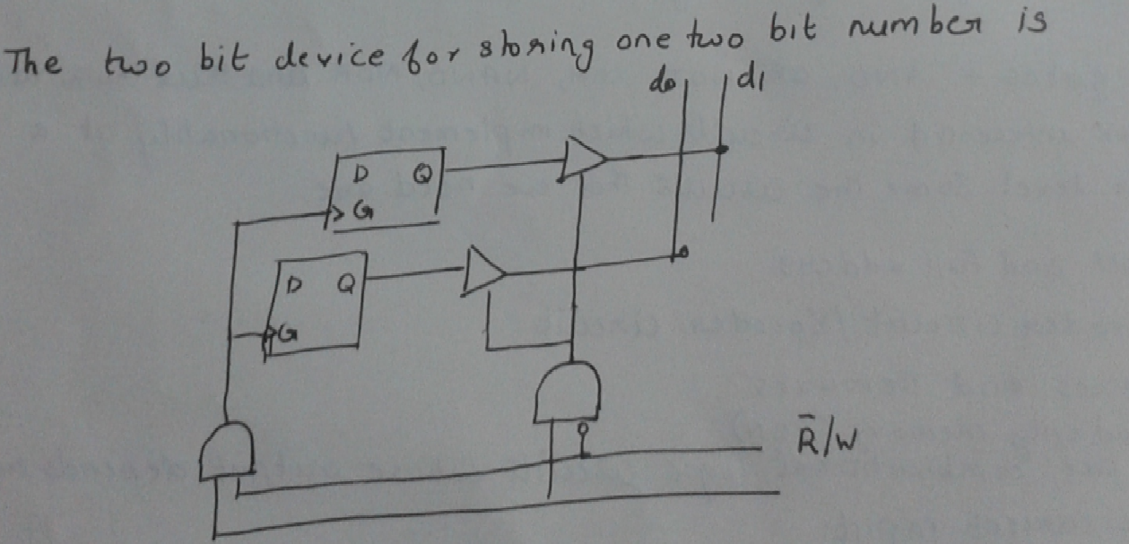
A basic memory cell
A two bit memory device

Slide 4
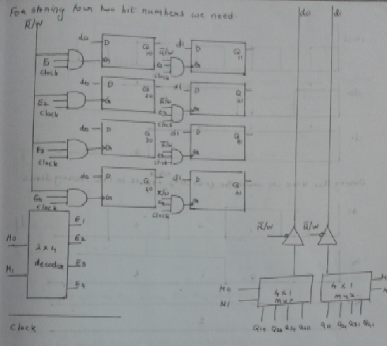
Memory device for storing four two bit numbers

Slide 5
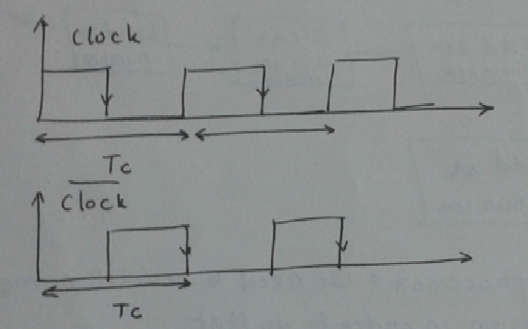
The clock
Periodic signal
Period is T_{c}
Clock frequency is 1/T_{c}
The state of our processor changes at the clock edges

Slide 6
The steps taken by the processor (via a finite state machine model)
Start
Load
3rd no
Add
1st no
Load
1st no
Load
4th no
Add
2nd no
Add
4th no
Load
2nd no
Clear
accu.
Add
3rd no

Slide 7
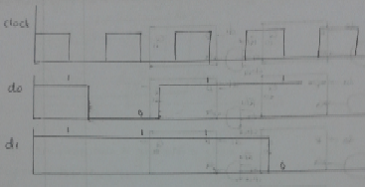
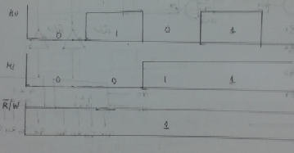
Operating the memory device for storing four two bit numbers
Clock and Data inputs (d0 and d1)
Control inputs M0, M1, and ~R/W

Slide 8
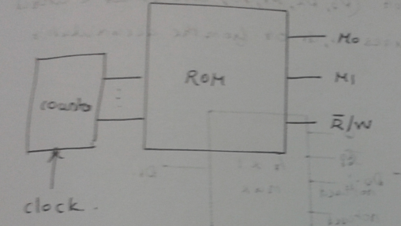
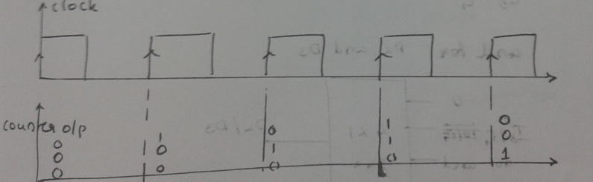
How to generate the control signals?
Use a counter (up-counter) as the memory address for a read only memory (ROM)
The ROM is hardcoded with the values of the control signals
C2 | C1 | C0 | M0 | M1 | ~R/W
0 | 0 | 0 | 0 | 0 | 1
0 | 0 | 1 | 0 | 1 | 1
0 | 1 | 0 | 1 | 0 | 1
... | ... | ... | ... | ... | ...
What is a counter?
Sequential circuits - counts clock transitions
Exercise: Find out how a counter is implemented using flip flops.

Slide 9
The steps taken by the processor (via a finite state machine model)
Start
Load
3rd no
Add
1st no
Load
1st no
Load
4th no
Add
2nd no
Add
4th no
Load
2nd no
Clear
accu.
Add
3rd no

Slide 10
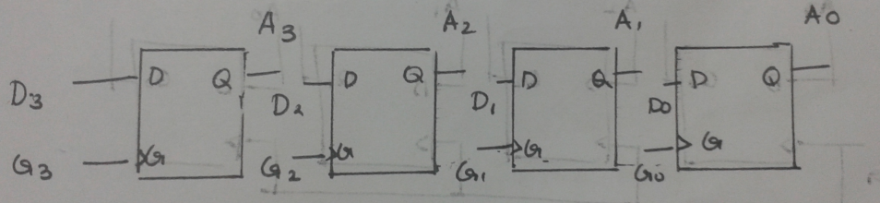
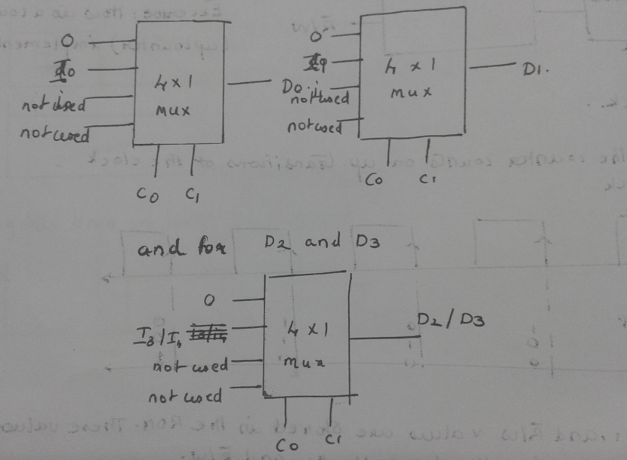
The accumulator for storing the sum
4 bit register
The accumulator input can be of two types
Either zero (if we want to clear the accumulator)
The result of the sum of the accumulator contents and a two bit value

Slide 11
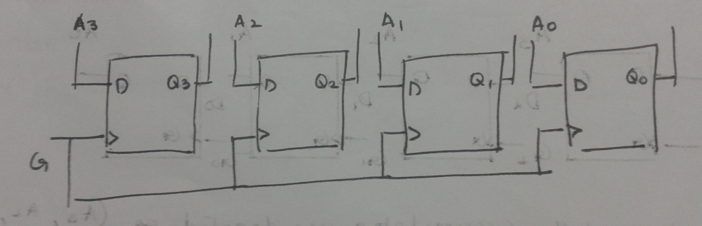
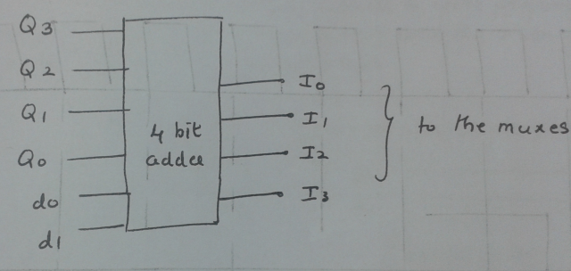
Temporary register & adder for accumulation of the sum
The temporary register is used to make sure that there is no instability while feeding back the contents of the accumulator
The adder adds together the contents of the temporary register and the inputs from the datalines d0 and d1

Slide 12
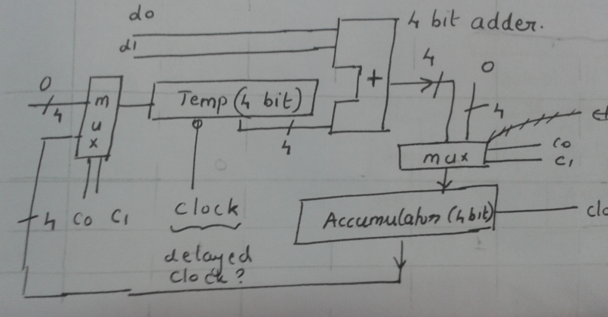
An initial design for the accumulator with additional circuits for implementing clear and add

Slide 13
The steps taken by the processor (via a finite state machine model)
Start
Load
3rd no
Add
1st no
Load
1st no
Load
4th no
Add
2nd no
Add
4th no
Load
2nd no
Clear
accu.
Add
3rd no

Slide 14
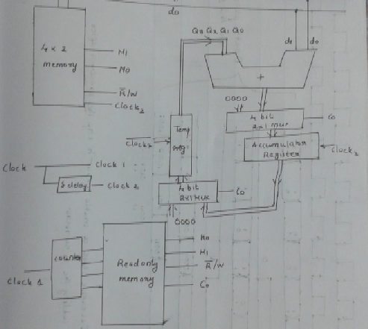
A simple processor
A design

Slide 15
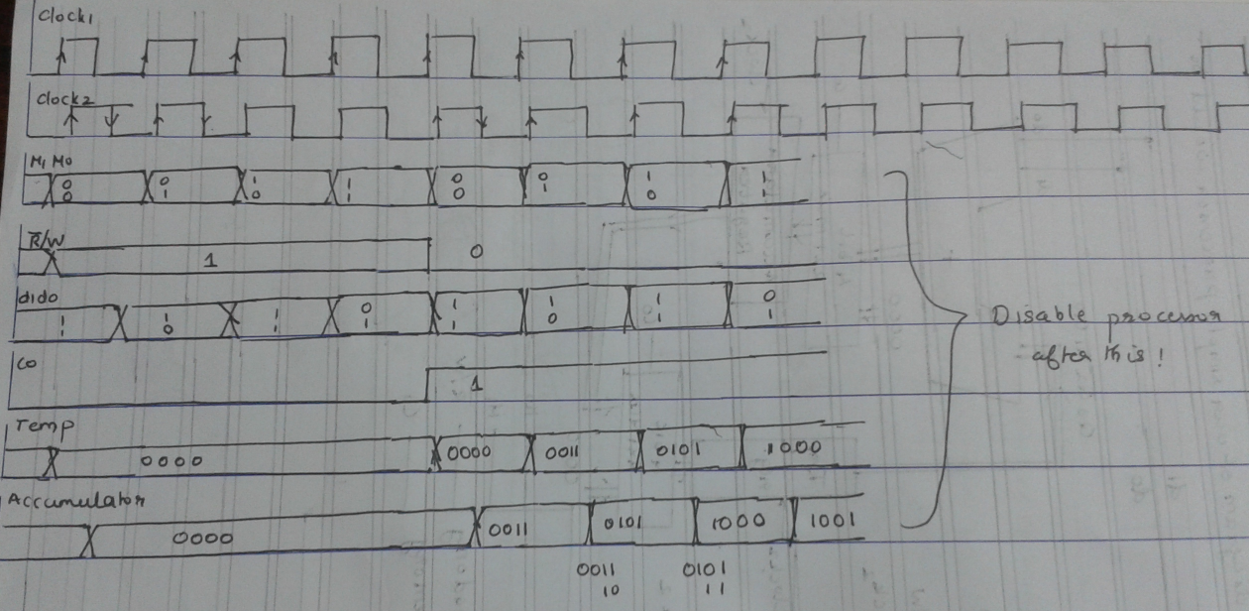
Timing diagram

Slide 16
Summary
Reviewed some aspects of digital logic design which are useful in understanding processor design
The major features of this example which needs to be remembered are
The finite state machine model used for describing the processor's working
The instruction ROM and the feature that control signals can be hardcoded into the memory within the ROM
Registers
The use of multiplexers in the processor to handle different kinds of data (different addressing modes)
Isolation using tristate logic devices
Complex instructions (such as add 4 numbers) might take multiple clock cycles.
Simple instructions take one clock cycle
Difference between CISC and RISC
7. Executing two disjoint instructions in parallel
8. Iterative nature of design
References
Any good textbook on digital logic
Appendix (online) of Hennessy and Patterson (http://www.cs.tufts.edu/comp/140/)
Exercises
Implement logic for enabling and disabling the processor - draw the new arch. and timing diagram
Implement logic for enabling and disabling the memory device - draw the new arch. and timing diagram
Implement a 4 bit upcounter using flip flops

